Slide 2
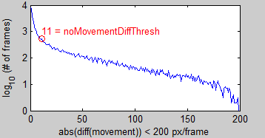
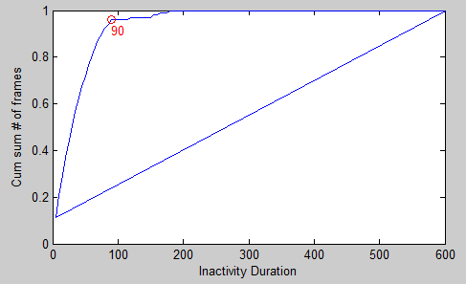
plotMovementFromNoMovementParameters.m
2) To be a “true” inactivity bout, must remain below the movement differential threshold for at least 90 frames
1)Use the first order differential of the movement to determine the threshold for no movement (calculated from the first inflection point)

Slide 3
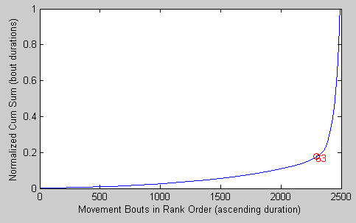
plotMovementFromNoMovementParameters.m
3) Movement bouts less than 63 seconds long are then assigned as micromovements.

Slide 4
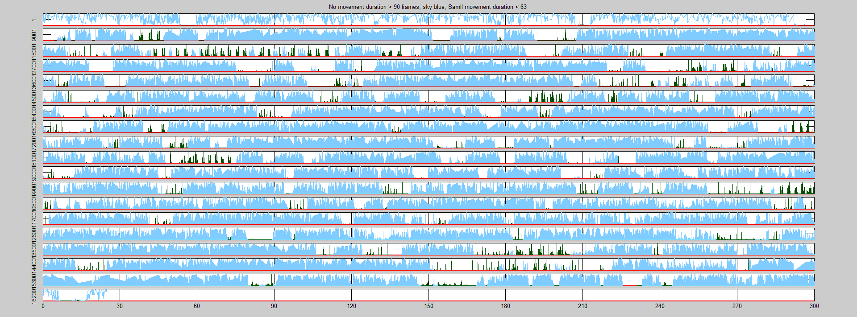
Have successfully used plotMovementFromNoMovementParameters.m to identify micromovements for 201102 awake fly

Slide 5
Next steps:
Run on three sleep deprived flies and three awake flies and see if the thresholds can/should be combined across multiple flies.
Annotate and check assignments.

Slide 6
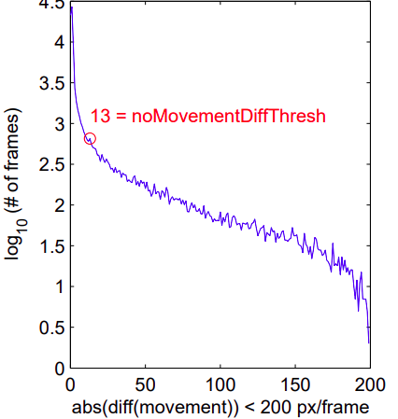
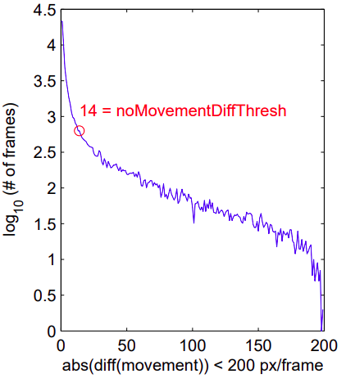
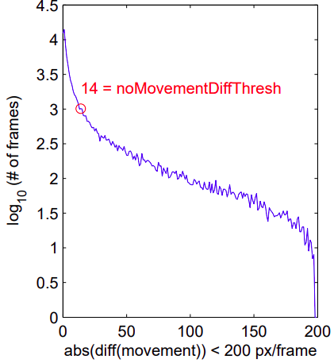
1)Threshold of first order differential of the movement to determine the threshold for no movement (calculated from the first inflection point)
201102
200814
ZT0-4 (no sleep dep)
200914
200915
ZT0-4 (with sleep dep)

